Slide 1
MHSF ROORKEE DESIGN REPORT
Asahi India Glass Limited
Prepared By: Mansi Singh
Date: 16-01-2024

Slide 2
CONTENTS
Machine overview P-3
Locator Pin Fixing Procedure P-4

Slide 3
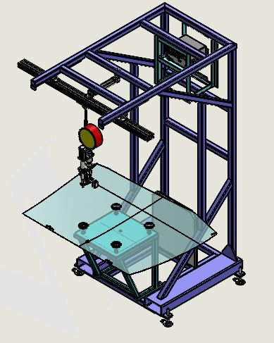
MHSF DESIGN ROORKEE
MODEL
OVERVIEW-
Ultrasonic welding machine for fixing locator pins on glass.
Essential for accurate component placement in manufacturing processes.
PURPOSE-
To fix locator pins on glass with ultrasonic welding enables accurate and consistent component placement.
IMPORTANT ITEMS-
Generator
Probe
Aluminium Booster
Titanium Horn

Slide 4
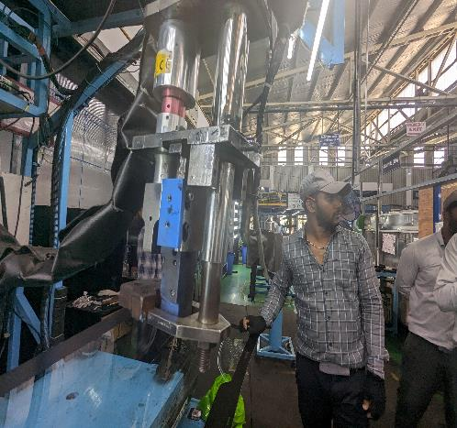
STEP BY STEP MHSF MACHINE PROCESS
Step 1- Cleaning the notch marking area on glass with the lint.
Step 2- Applying SU10 primer to the notch marking area.
Step 3- Glass is placed over the table and vacuum cups suck the glass.
Step 4- Pulling the rope of the probe assembly to insert the locator pin into the cavity mounted on the horn.
Step 5- Positioning the cavity and took position of the glass, then stopper will butt glass.
Step 6- The limit switch sense that glass butt or not.
Step 7- Cycle starts >>> By pressing the start switch, clamping cylinder will go down after the confirming the cylinder going down, Ultrasonic wave generator on with manual time.
Step 8- Generating heat in the booster (80-90% within 0.9 seconds).
Step 9- Melting the nylon rubber on the locator pin.
Step 10- Flowing molten material between surfaces.
Step 11- Solidifying the material to form a bond.
Step 12- Releasing contact after 0.9 seconds.
Step 13- Cylinder goes up and vacuum release <<< cycle completed.
*Manual By AIS BLR- Link

Slide 5


